Slide 1
Control Statements
Control statements are used to control the flow of execution depending upon the specified condition/logic.
There are three types of control statements.
Decision Making Statements
Iteration Statements (Loops)
Jump Statements (break, continue, pass)

Slide 2
Decision Making Statement
Decision making statement used to control the flow of execution of program depending upon condition.
There are three types of decision making statement.
if statements
if-else statements
Nested if-else statement

Slide 3

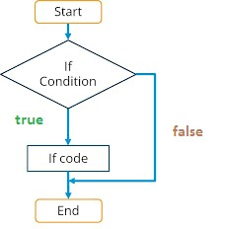
Decision Making Statement
1. if statements
An if statement is a programming conditional statement that, if proved true, performs a function or displays information.

Slide 4
Decision Making Statement
1. if statements
Syntax:
if(condition):
statement
[statements]
e.g. noofbooks = 2
if (noofbooks == 2):
print('You have ') print(‘two books’)
print(‘outside of if statement’)
Output
You have two books
Note:To indicate a block of code in Python, you must indent each line of the block by the same amount. In above e.g. both print statements are part of if condition because of both are at same level indented but not the third print statement.

Slide 5
Decision Making Statement
1. if statements
Using logical operator in if statement
x=1 y=2
if(x==1 and y==2):
print(‘condition matcing the criteria')
Output :-
condition matcing the criteria
-----------------------------------------------------------
a=100
if not(a == 20):
print('a is not equal to 20')
Output :-
a is not equal to 20

Slide 6

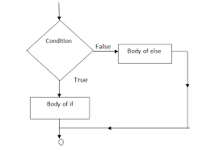
Decision Making Statement
2. if-else Statements
If-else statement executes some code if the test expression is true (nonzero) and some other code if the test expression is false.

Slide 7
Decision Making Statement
2. if-else Statements
Syntax:
if(condition):
statements
else:
statements
e.g.
a=10
if(a < 100):
print(‘less than 100')
else:
print(‘more than equal 100')
OUTPUT
less than 100
*Write a program in python to check that entered numer is even or odd

Slide 8

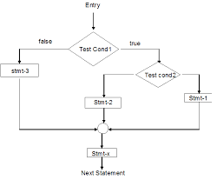
Decision Making Statement
3. Nested if-else statement
The nested if...else statement allows you to check for multiple test expressions and execute different codes for more than two conditions.

Slide 9
Decision Making Statement
3. Nested if-else statement
Syntax
If (condition):
statements elif (condition):
statements
else:
statements
E.G.
num = float(input("Enter a number: ")) if num >= 0:
if num == 0:
print("Zero")
else:
print("Positive number") else:
print("Negative number") OUTPUT
Enter a number: 5
Positive number
* Write python program to find out largest of 3 numbers.

Slide 10
Iteration Statements (Loops)
Iteration statements(loop) are used to execute a block
of statements as long as the condition is true.
Loops statements are used when we need to run same code again and again.
Python Iteration (Loops) statements are of three type :-
While Loop
For Loop
Nested For Loops

Slide 11

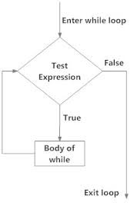

Iteration Statements (Loops)
1. While Loop
It is used to execute a block of statement as long as a given condition is true. And when the condition become false, the control will come out of the loop. The
condition is checked every time at the beginning of the loop.
Syntax
while (condition):
statement [statements]
e.g.
x = 1
Output
1
2
3
4
while (x <= 4): print(x)
x = x + 1

Slide 12


Iteration Statements (Loops)
While Loop continue
While Loop With Else
e.g.
x = 1
while (x < 3):
print('inside while loop value of x is ',x) x = x + 1
else:
print('inside else value of x is ', x)
Output
inside while loop value of x is 1 inside while loop value of x is 2 inside else value of x is 5
*Write a program in python to find out the factorial of a given
number

Slide 13
Iteration Statements (Loops)
While Loop continue
Infinite While Loop
e.g.
x = 5
while (x == 5): print(‘inside loop')
Output Inside loop Inside loop
…
…

Slide 14
Iteration Statements (Loops)
2. For Loop
It is used to iterate over items of any sequence, such as a list or a string.
Syntax
for val in sequence:
statements
e.g.
for i in range(3,5): print(i)
Output 3
4

Slide 15
Iteration Statements (Loops)
2. For Loop continue
Example programs
for i in range(5,3,-1):
print(i)
Output
5
4
range() Function Parameters
start: Starting number of the sequence.
stop: Generate numbers up to, but not including this number. step(Optional): Determines the increment between each numbers in the sequence.

Slide 16
Iteration Statements (Loops)
2. For Loop continue
For Loop With Else
e.g.
for i in range(1, 4): print(i)
else: # Executed because no break in for print("No Break")
Output
1
2
3
4
No Break

Slide 17
Iteration Statements (Loops)
2. For Loop continue
Nested For Loop
e.g.
for i in range(1,3): for j in range(1,11):
k=i*j
print (k, end=' ')
print()
Output
1 2 3 4 5 6 7 8 9 10
2 4 6 8 10 12 14 16 18 20

Slide 18
Iteration Statements (Loops)
3. Jump Statements
 | Jump | statements | are | used | to | transfer
the | program's | control from | one | location | to | another.
Means these are used to alter the flow of a loop like - to skip a part of a loop or terminate a loop
There are three types of jump statements used in python.
1.break 2.continue 3.pass

Slide 19
Iteration Statements (Loops)
1.break
it is used to terminate the loop.
e.g.
for val in "string": if val == "i": break
print(val)
print("The end")
Output
s t r
The end

Slide 20
Iteration Statements (Loops)
2.continue
It is used to skip all the remaining statements in the loop and move controls back to the top of the loop. e.g.
for val in "init": if val == "i":
continue print(val)
print("The end")
Output
n
t
The end

Slide 21
Iteration Statements (Loops)
3. pass Statement
This statement does nothing. It can be used when a statement is required syntactically but the program requires no action.
Use in loop
while True:
pass # Busy-wait for keyboard interrupt (Ctrl+C)
In function
It makes a controller to pass by without executing any code.
e.g.
def myfun():
pass #if we don’t use pass here then error message will be shown print(‘my program')
OUTPUT
My program

Slide 22
Iteration Statements (Loops)
3. pass Statement continue
e.g.
for i in 'initial':
if(i == 'i'):
pass else:
print(i)
OUTPUT
n t a L
NOTE : continue forces the loop to start at the next iteration while pass means "there is no code to execute here" and will continue through the remainder or the loop body.

